Slide 1
GUI in Python (tkinter)
Shyam khatiwada

Slide 2
Python GUI:
we will learn how to develop graphical user interfaces by writing some Python GUI examples using the Tkinter package.
Tkinter package is shipped with Python as a standard package, so we don’t need to install anything to use it.

Slide 3
Steps to create Gui applications:
Import the Tkinter module.
Create the GUI application main window.
Add one or more of widgets to the GUI application.
Enter the main event loop to take action against each event triggered by the user.
Widgets: Tkinter provides various controls, such as buttons, labels and text boxes used in
a GUI application. These controls are commonly called widgets.

Slide 4
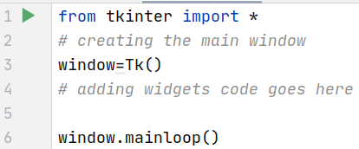
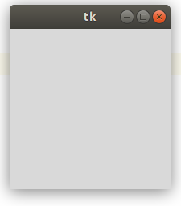
Code:

Slide 5
Widget classes:
There are many different widget classes built into tkinter – they should be familiar to you from other GUIs:
A Frame is a container widget which is placed inside a window, which can have its own border and background – it is used to group related widgets together in an application’s layout.
Toplevel is a container widget which is displayed as a separate window.
Canvas is a widget for drawing graphics. In advanced usage, it can also be used to create custom widgets – because we can draw anything we like inside it, and make it interactive.
Text displays formatted text, which can be editable and can have embedded images.

Slide 6
Widget Classes:
A Button usually maps directly onto a user action – when the user clicks on a button, something should happen.
A Label is a simple widget which displays a short piece of text or an image, but usually isn’t interactive.
A Message is similar to a Label but is designed for longer bodies of text which need to be wrapped.
A Scrollbar allows the user to scroll through content which is too large to be visible all at once.
Checkbutton, Radiobutton, Listbox, Entry and Scale are different kinds of input widgets – they allow the user to enter information into the program.
Menu and Menubutton are used to create pull-down menus.

Slide 7
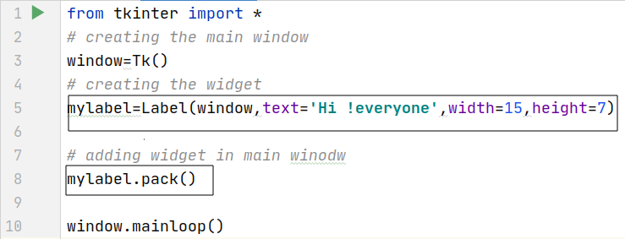
Adding widgets in main window:
Important- There are different attributes of widgets to perfrom specific changes to the widgets.

Slide 8
Geometry Management:
All widgets in Tkinter have some geometry measurements. These geometry measurements allow you to organize the widgets and throughout the parent frames or parent widget area.
One of the geometry management classes, i.e., pack(), has already been covered here.
For this purpose, Tkinter provides you with three main geometry manager classes:
pack(): It organizes the widgets in a block manner, and the complete available width is occupied by it. It's a conventional method to show the widgets in the window.
grid(): It organizes the widgets in a table-like structure. You will learn about it in detail later in this tutorial.
place(): Its purpose is to place the widgets at a specific position as instructed by the user in the parent widget.

Slide 9
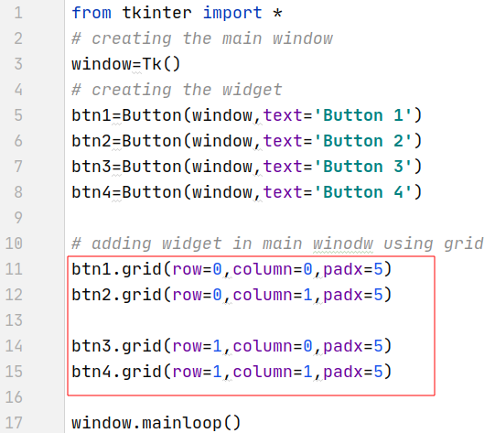
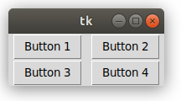
grid() method:
Attributes of grid method-
row-specify the row for widgets
column-specify the column for widgets
padx-padding horizontal
pady-padding vertically

Slide 10
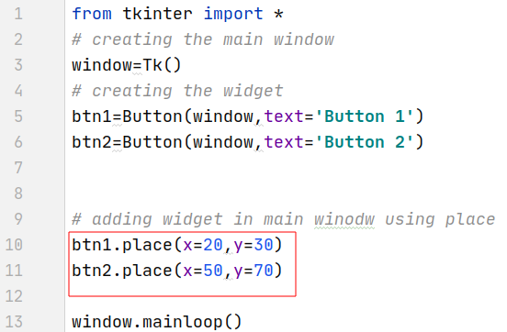
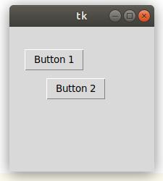
Place() method:

Slide 11
Events and Binds
A Tkinter application runs most of its time inside an event loop, which is entered via the mainloop method. It waiting for events to happen. Events can be key presses or mouse operations by the user.
Tkinter provides a mechanism to let the programmer deal with events. For each widget, it's possible to bind Python functions and methods to an event.
widget.bind(event, handler)
If the defined event occurs in the widget, the "handler" function is called with an event object. describing the event.

Slide 12
Types of Event:
Events are uniquely identified by a sequence name in string format – the format is described by a mini-language which is not specific to Python. Here are a few examples of common events:
"<Button-1>", "<Button-2>" and "<Button-3>" are events which signal that a particular mouse button has been pressed while the mouse cursor is positioned over the widget in question. Button 1 is the left mouse button, Button 3 is the right, and Button 2 the middle button – but remember that not all mice have a middle button.
"<ButtonRelease-1>" indicates that the left button has been released.
"<B1-Motion>" indicates that the mouse was moved while the left button was pressed (we can use B2 or B3 for the other buttons).
"<Enter>" and "<Leave>" tell us that the mouse curson has entered or left the widget.
"<Key>" means that any key on the keyboard was pressed. We can also listen for specific key presses, for example "<Return>" (the enter key), or combinations like "<Shift-Up>" (shift-up-arrow). Key presses of most printable characters are expressed as the bare characters, without brackets – for example, the letter a is just "a".
"<Configure>" means that the widget has changed size.

Slide 13
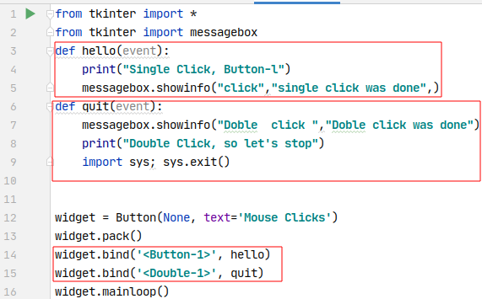
Example 1:

Slide 14
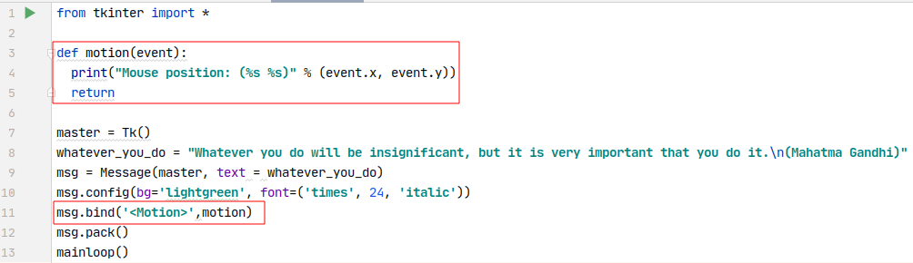
Example 2:

Slide 15
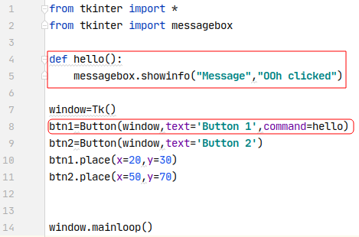
Event using command attributes:

Slide 16
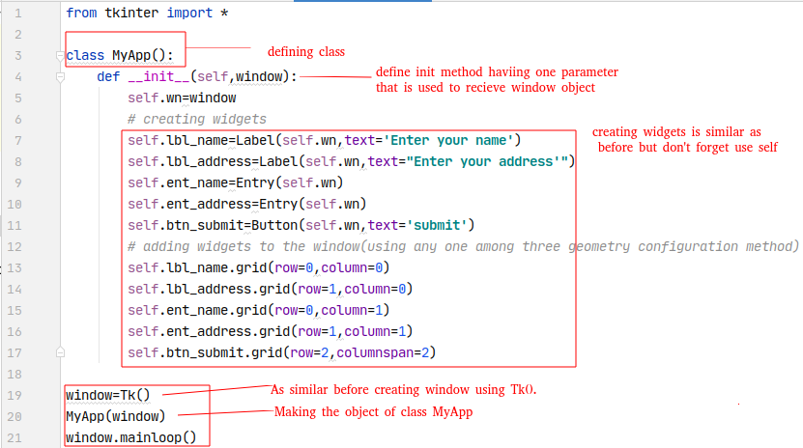
Creating Gui using class:

Slide 17
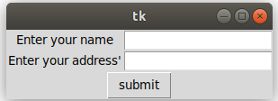
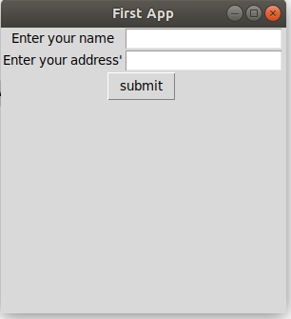
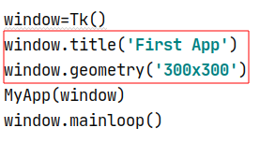
Output:
Changing the window size and setting title of winodw

Slide 18
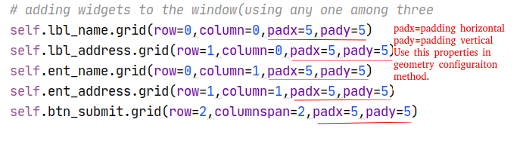
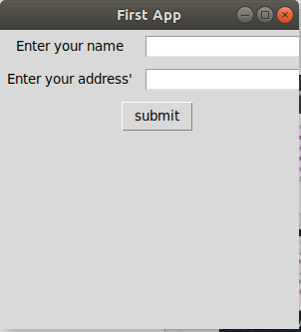
Padding between widgets:

Slide 19
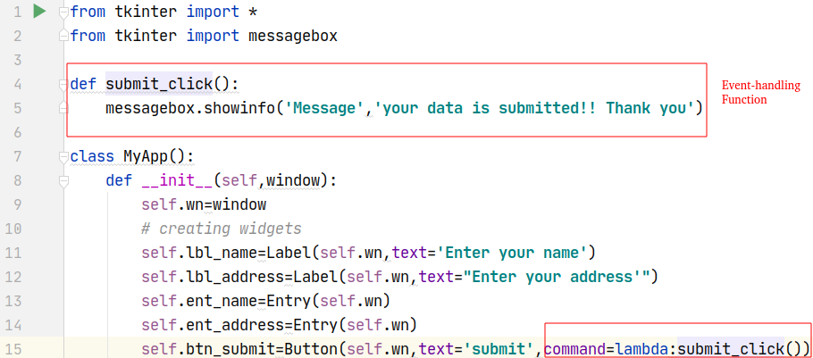
Event-Handling:

Slide 20
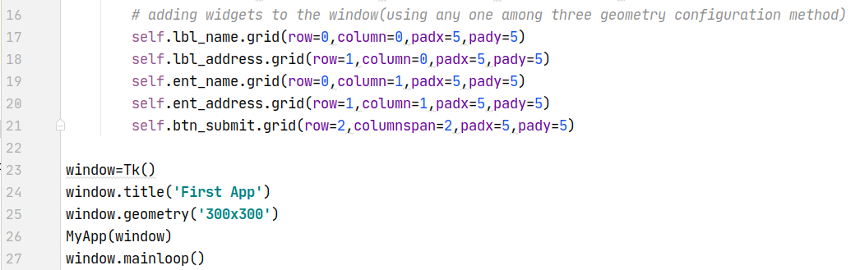
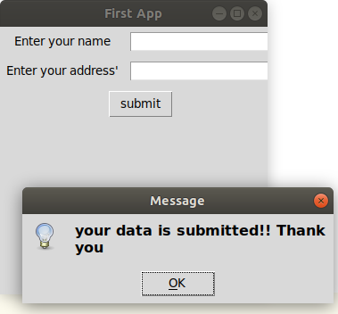
Event-Handling:
Click submit button

